Slide 1
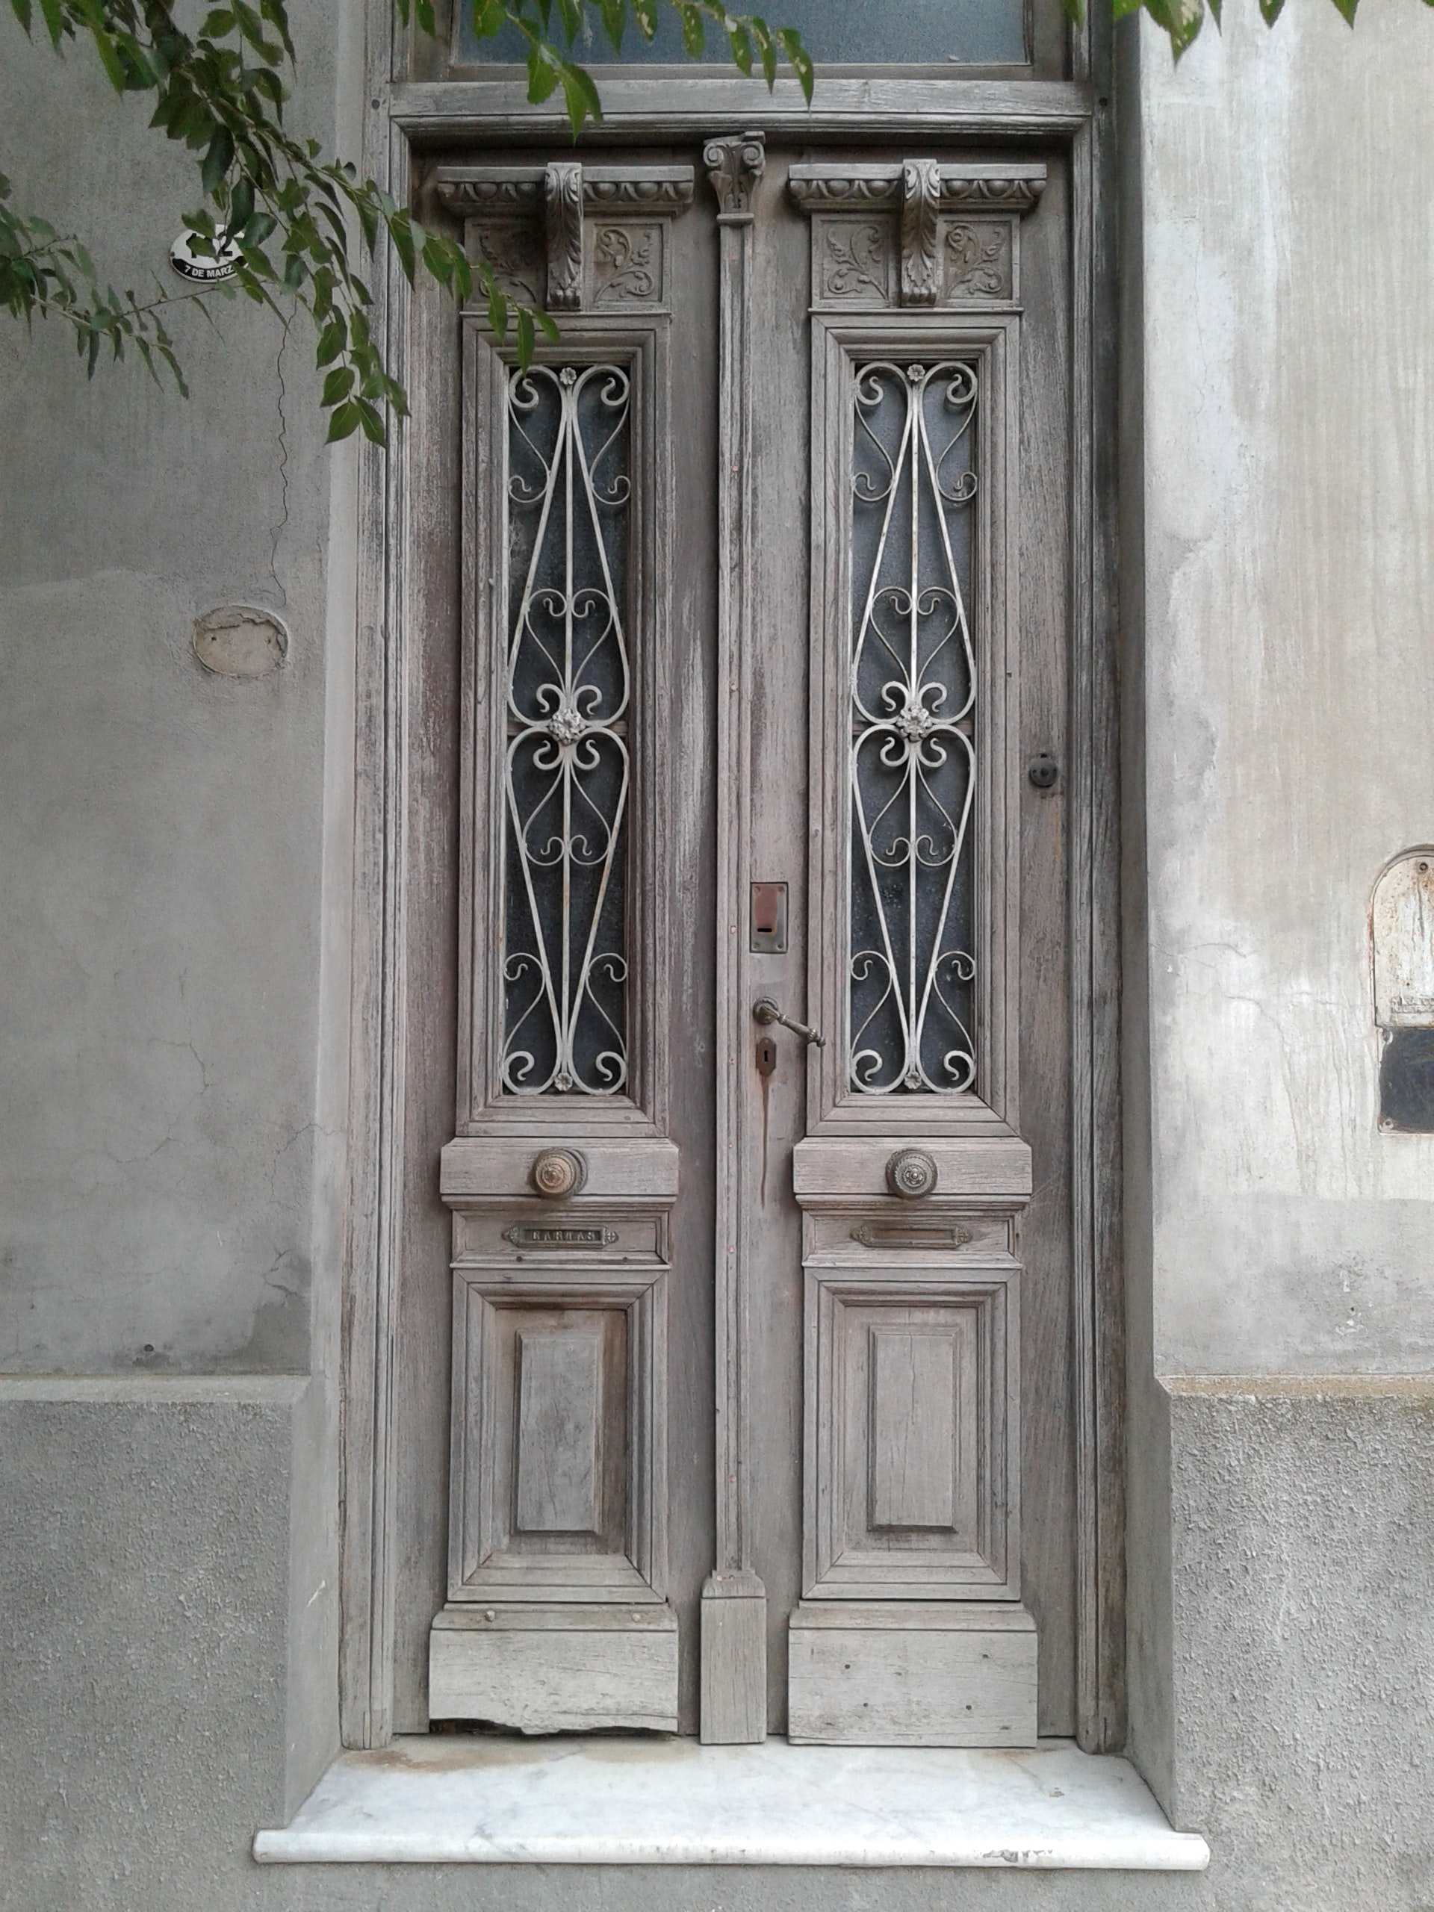
What’s Happening
this week…
27^{th June 2022} – 1^{st July 2022}

Slide 2
Social Activities:
Monday 27t^{th} June 2022 9am Therapeutic Water Aerobics 10am Art class 10am Knit & Natter 1pm Duplicate Bridge 5pm Snooker / Pool + Waterhole
Tuesday 28th June 2022 9am Therapeutic Exercise class 2.30pm Crafters Club 2.30pm Scrabble 5pm Ladies Pool + Waterhole
Wednesday 29th June 2022 10am Art Class 5.30pm Social dinner
Thursday 30th June 2022 9am Yoga – contact Kiloran (House 63) 10am Kind to Hearing 2pm Bridge 3pm Petanque 6pm Movie Night
Friday 1st July 2022 9am Beginners Line Dancing Class 9.30am Line Dancing – Main Class 10:30am Bible Study 12:30pm Fish and Chips 5pm Waterhole

