Slide 1
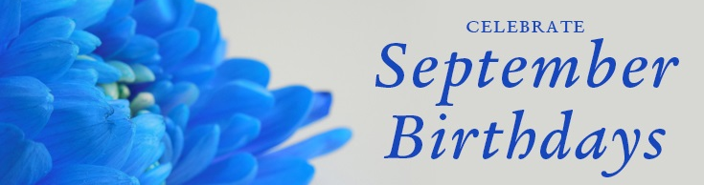
2nd Kathy Möhlig (63rd)
4th Wally Ross (72nd)
5th Henrietta Dobrowolski (77th)
6th Joanna Schneider (82nd)
7th Sarah Knibbs (82nd)
9th Penelope Rabinowitz (78th)
10th Derek Schuurman (85th)
11th Linda Brennan (71st)
12th Felicity Brandt (76th)
12th Edna Grenfell (71st)
13th Manfred Leitner (82nd)
15th Heather Mutch (71st)
19th Sue Hartley (69th)
21st Helen Knowles (73rd)
26th Judy Stuart (77th)

Slide 2
