Slide 1
What’s Happening Next Week
10 – 16 February 2020
Compiled by René Kleynhans

Slide 2
Social Activities
Monday, 10 February 2020 8.15am Aquatics 10am Art Classes 10am Knit & Natter 1pm Duplicate Bridge 5pm Snooker / Pool 7pm Rummikub | Tuesday, 11 February 2020 8am Exercise Class 9am Exercise Class 2.30pm Scrabble 5pm Snooker / Pool | Wednesday, 12 February 2020 10am Art Class 5pm Wine Tasting Social Evening
Thursday, 13 February 2020 7.30am Exercise Class 10am Specialist Movies from the Arts 2pm Cancer Awareness Talk by Sr Marius 6.30pm Movie Evening
Friday, 14 February 2020 9am Beginners Line Dancing 10am Line Dancing 10.30am Christian Bible Study 2.30pm Bingo! 3.00 Gathering for Eddie Simpson at the Bistro 5pm Waterhole | Saturday, 15 February 2020 10am – 1pm Sales Event

Slide 3
Happy Birthday
1st Pretty Mdluli
2nd Peta Nesbitt
6th Stuart Phillips
7th Jane MacConachie
15th Heather Allan

Slide 4
Weekly Menu
R48.00 per person
Confirm bookings daily by 9am with The Bistro on ext. 1209
Monday, 10 February 2020 Cheese Burger & Chips, Onion Rings & Green Salad | Tuesday, 11 February 2020 Penne Puttanesca & Chopped Salad | Wednesday, 12 February 2020 Sesame Beef Stir-fry & Rice Noodles | Thursday, 13 February 2020 Chicken Spring Rolls, Sweet Chili & Soy Sauce with Asian Salad | Friday, 14 February 2020 Fried Fish with Tartar Sauce, Chips & Coleslaw

Slide 5
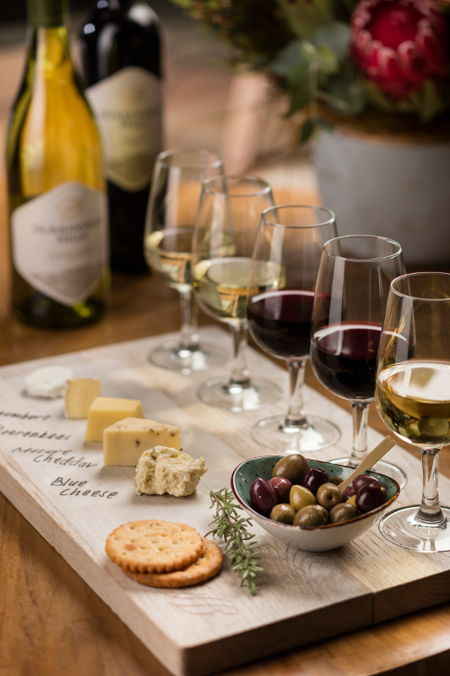
Wednesday
12 February 2020
Wine Tasting
R65.00 per person
Confirm bookings by Tuesday, 9am with The Bistro on ext. 1209
Starter
Fruit & Snack Platter
Wine Tasting
Home-Made Lemon Sorbet
Main
Thai chicken Curry,
Coriander & Coconut Rice,
Stir-fry Vegetables

Slide 6
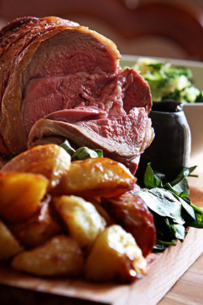
Sunday Lunch
16 February 2020
R76.00 per person
Please request GLUTEN FREE option when booking
Confirm bookings by Friday, 4pm with The Bistro on ext. 1209
Starter
Caprese Tartlet
Main
Roast Beef & Red Wine Gravy,
Potato Bake & Sautéed Vegetables
Dessert
Ice Cream Sunday

Slide 7
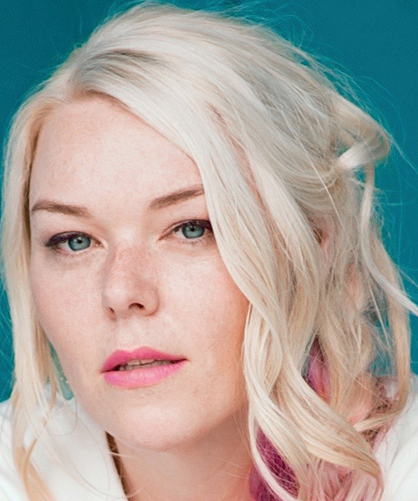
Important Dates to Diarize
Valentine’s Day Wine Tasting Dinner
12 February 2020
Sales Event
15 February 2020
Book Club
18 February 2020
ResCom Six Month Feedback Meeting
26 February 2020

Slide 8
Join us for a talk on
Presented by: Sr Marius Grobler
Date: 13 February 2020
Time: 2pm
Venue: Evergreen Lifestyle Centre

Slide 9
Cancer
awareness
ribbons

Slide 10
Entertainment
Richard O’Brien’s Rocky Horror Show
From: 17 January 2020 to 1 March 2020
Venue: The Teatro
Times:
Wednesday – Friday: 20h00
Saturday: 15h00 & 20h00
Sunday: 14h00 & 18h00
Tickets: R100 – R500
EXPO’S
21 – 23 February 2020: Caravan, Camp and Destination Show
27 February 2020 – 1 March 2020: Gauteng Homemakers Expo
28 February 2020 – 1 March 2020: Travel Expo
29 February 2020 – 1 March 2020: Canine Zone Crazy Pawsome Love Pet Expo
5 – 8 March 2020: Hobby-X Johannesburg
14 – 15 March 2020: The Wedding Expo
8 – 13 April 2020: Rand Show 2020
8 – 10 May 2020: Natural & Organic Expo comes to SA
17 – 19 July 2020: Coffee & Chocolate Expo
26 – 29 November 2020: Cannabis Expo

