Slide 1
What’s Happening Next Week
20 January 2020 – 26 January 2020

Slide 2
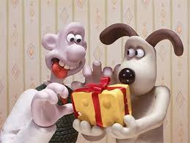
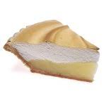
Social Activities
Monday, 20 January 2020 National Cheese Lover’s Day 8.15am Aquatics 10am Art Classes 10am Knit & Natter 1pm Duplicate Bridge 5pm Snooker / Pool | Tuesday, 21 January 2020 National Banana Bread Day 8am Exercise Class 9am Exercise Class 2.30pm Scrabble 5pm Snooker / Pool | Wednesday, 22 January 2020 Robert Burn’s Celebration 10am Art Class 5pm Burns Night Social Evening | Thursday, 23 January 2020 National Pie Day 7.30am Exercise Class 10am Specialist Movies from the Arts 6.30pm Movie Evening | Friday, 24 January 2020 National Peanut Butter Day 9am Beginners Line Dancing 10am Line Dancing 10.30am Christian Bible Study 5pm Waterhole

Slide 6
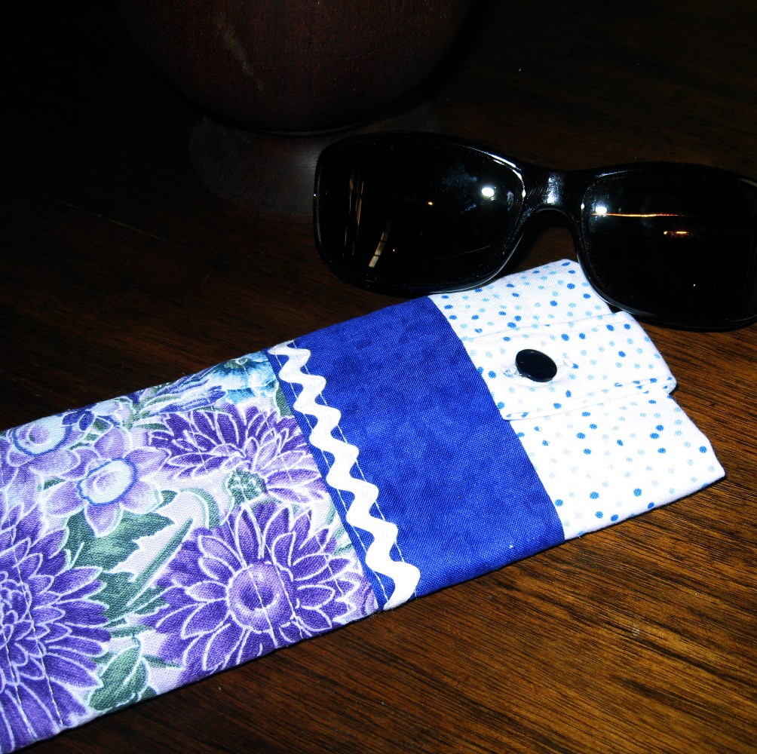
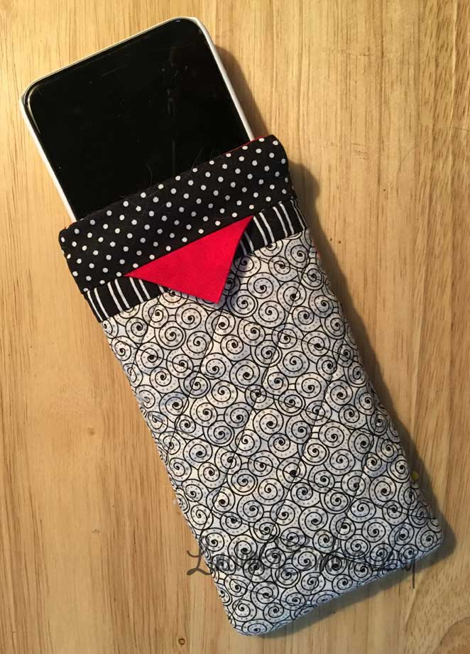
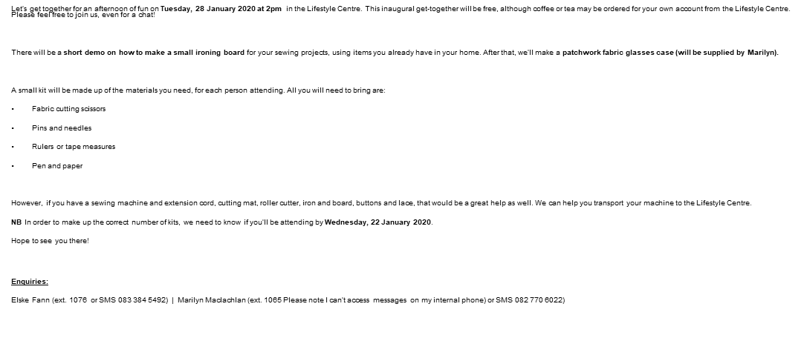
Craft Afternoon
Tuesday, 28 January 2020

