Slide 2
PLEASE VISIT OUR BEAUTIFUL WEBSITE
WWW.IVORIDENTISTRY.COM

Slide 3
Information package for family members and patients
Dentist to your door! Coming to you in 2020!

Slide 4
dr botha’s journey to frail care centres and retirement villages
At IVORI Dentistry we realise the need for dentists who can travel to your doorstep. Many patients and their loved ones are overwhelmed by the tiresome and costly journey met with long-waiting periods, typical of a visit to the dentist.
One such patient was Nana, grandmother to Dr Daniella Botha-founder of IVORI Dentistry. Nana suffered from Alzheimer’s and was bedridden for the last ten years of her life, making it extremely difficult to get her to the dentist when she suffered from toothache or needed a denture.
Dr Botha knew that Nana’s difficulties were shared by many and most severely, the disabled and elderly populations. Her solution was simple: mobile dental care and thus, IVORI Dentistry was born. IVORI Dentistry seeks to provide quality dental care for everyone's Nana.

Slide 5
FIRST THINGS FIRST
Dr Botha will visit the frail care centre and retirement village on a pre-determined day where consultations and cleanings will be provided at a set fee.
A list of patients that require further treatment will be determined.
Quotes of required treatment will be sent to patients or family members for patients who cannot speak for themselves .
Follow-up dates will be scheduled where all patients requiring further treatment will be seen on the same day.

Slide 6
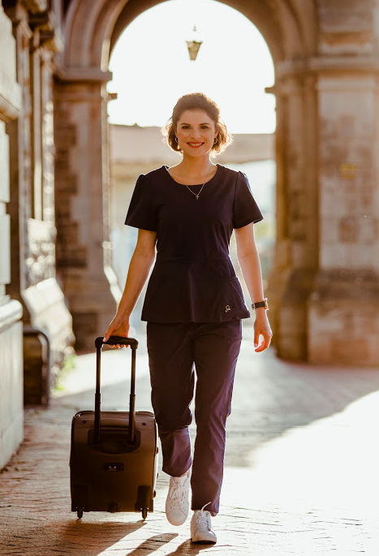
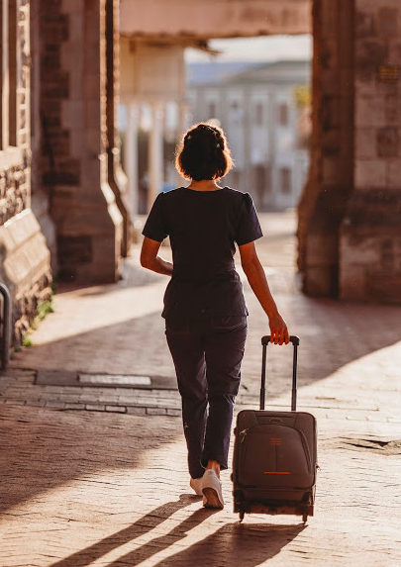
On the day of treatment?
Dr Botha will arrive with all of the necessary equipment required to treat her patients.
She will set up in a space sized 4m x 3m in approximately 10 minutes.
She will call the patients in one by one for their appointments.
Patients who are immobile will be treated in their personal space.
After treatment Dr Botha will pack up and leave the space exactly as she found it.

Slide 7
HOW DOES IT WORK for patients that cannot give consent?
For patients that are not able to give consent themselves;
Dr Botha will contact the family members for the following:
Permission to proceed with a follow-up visit.
An estimated quote for the required treatment in totality.
Once permission has been obtained, some forms and further information will be sent to the family before the follow-up visit.

Slide 8
What about payment?
We accept ; cash, debit or credit card, retail cards and EFTs. We are also affiliated with MediConnect where patients may take out loans.
Patients who would like to claim from medical aid will be provided with all of the information necessary to do so (we do not claim on the patient’s behalf).
The initial visit for cleanings and consultations (and x-rays if necessary) will be a set fee per patient. Patients or loved ones are therefore required to pay this fee either before or on the day of treatment.
Patients who require further treatment; quotes will be generated and Dr Botha will return on a pre-determined date in order to continue with the treatment. Invoices will be sent after each additional visit, to be paid before the next visit.

Slide 9
Still a little unsure? No problem
You are more than welcome to contact me! Let’s get together, chat over e-mail or set up a phone call.
All information is also available on the website www.ivoridentistry.com
My door is always open, just organize a time to come and see me or for me to come and see you.
Loved ones are of course welcome to join at the appointment to!

Slide 10
SEE YOU
IN 2020!

