Slide 1
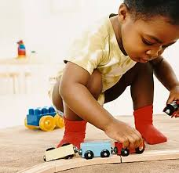
HOPE HOUSE 2020
BUY A CHRISTMAS GIFT FOR AN UNDER-PRIVALEGED CHILD
AGE 4-12
Wrap the gift and clearly mark on a label whether it’s for a boy or a girl and identify age.
Place it in the box provided at reception.
DEADLINE:
25 NOVEMBER
ADD DATE AND TIME HERE

