Slide 1
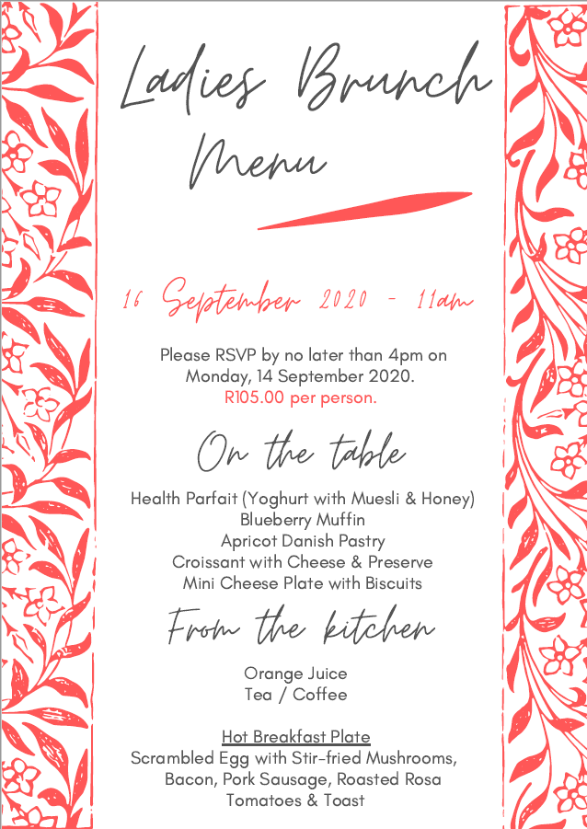
LIMITED SEATING AVAILABLE DUE TO SOCIAL DISTANCING – PLEASE BOOK EARLY

