Slide 1
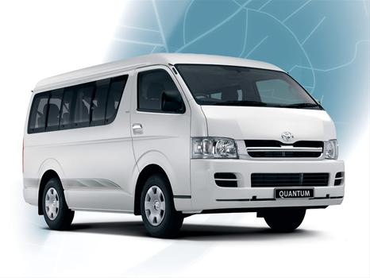
EVERGREEN BERGVLIET
TRANSPORT SHUTTLE
on
TUESDAY – 12:45am
THURSDAY – 8:45pm
R20 per person/per trip
Meadowridge Shopping Centre/
Constantiaberg Hospital/ Constantia Village
- All shuttle bookings are to be made timeously at the reception desk on Ext 300 (limited seating available).
- Nominal fee will be billed direct to your levy account.
- A token/s will be issued for each trip. This token is to be handed to the driver when boarding.
- It is important that you wear your Telecare Buddy band.

