Slide 1
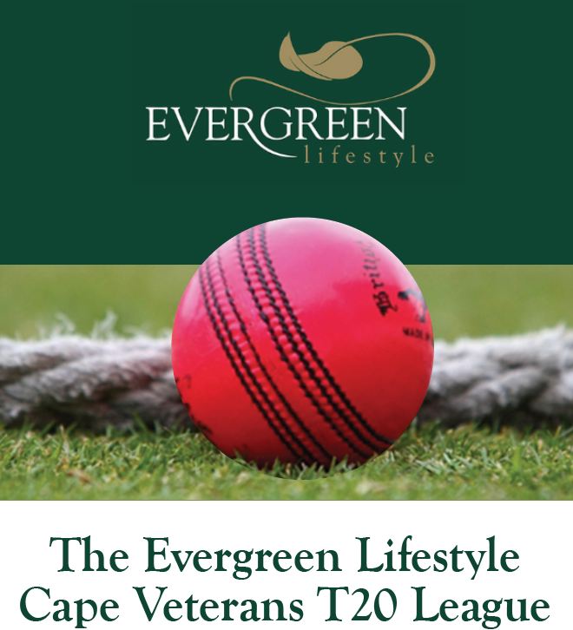

Please join us for a fun day out watching great cricket at the
Evergreen Lifestyle Cape Veterans T20 match
CLAREMONT vs RONDEBOSCH
Wednesday 19th February, 4pm
Rondebosch Cricket Club
RSVP to your Village Manager by 12th February 2020

